Slide 1
COMP1003 – Algorithms, Data Structures & Maths
Session 05
Special Functions, Derivative, Integral
Thomas Wennekers
University of Plymouth

Slide 2
Overview
Special Functions
Polynomials
Derivative
Integration

Slide 3
Special Functions

Slide 4
Certain functions are common in special contexts
They have got names and have been intensely studied
Power, cosine, sine, exponential, logarithms, etc.

Slide 5
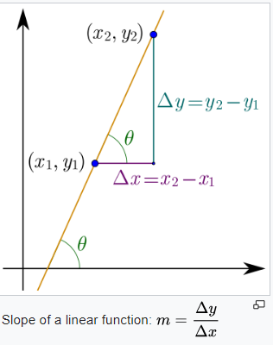



Linear Function y = f(x) = mx + b

Slide 6
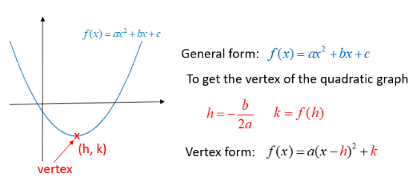
Quadratic Function

Slide 7

Quadratic Function
roots/zero crossings: f(x)=0
(can be complex numbers)

Slide 8

Compute the Roots

Slide 9
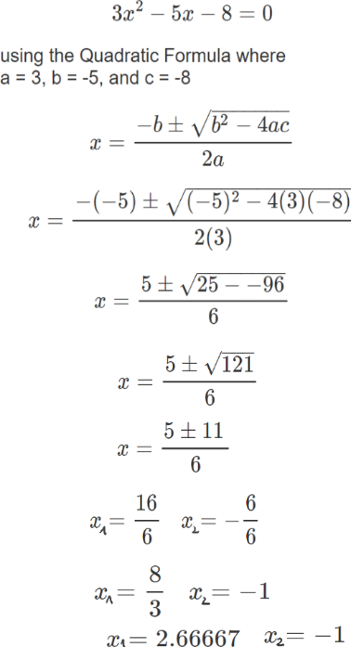
Compute the Roots

Slide 10
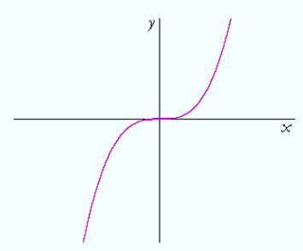
Cubic Equation y = f(x) = x*x*x = x³
x f(x)
1 1
-1 -1
0 0
2 8
-2 -8
…

Slide 11
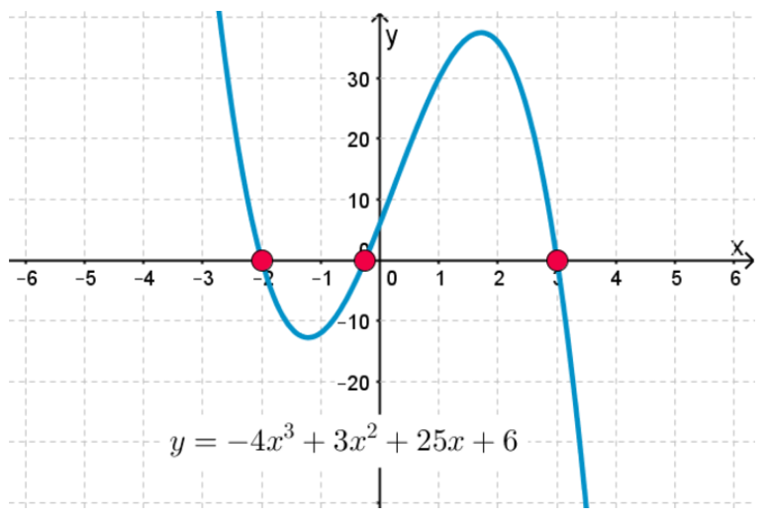
General Cubic Function
Formulas to compute zero crossings exist

Slide 12
General Cubic Function
Product form (may require complex numbers)
y = f(x) = (x + 2) (x - 3) (x + 1/4)

Slide 13
Power Function
y = f(x) = x^{n}
n natural number: x*x*…*x n factors
x² * x³ = x*x * x*x*x = x*x*x*x*x = x⁵ = x²⁺³

Slide 14
Power Function
y = f(x) = x^{n}
n natural number: x*x*…*x n factors
x² * x³ = x*x * x*x*x = x*x*x*x*x = x⁵ = x²⁺³
x² / x³ = x*x / (x*x*x) = 1/x = x⁻¹ = x²⁻³

Slide 15
Power Function
y = f(x) = x^{n}
n natural number: x*x*…*x n factors
x² * x³ = x*x * x*x*x = x*x*x*x*x = x⁵ = x²⁺³
x² / x³ = x*x / (x*x*x) = 1/x = x⁻¹ = x²⁻³
(x²)³ = (x*x)(x*x)(x*x) = x⁶ = x^{2*3}

Slide 16
Power Function
y = f(x) = x^{n}
n real: same laws apply
X^{2.4} * x^{3.1} = x^{5.5}
X^{2.1} / x³ = x^{-.9} = 1/ x^{.9}
(x^{2.5})^{-3.3} = x^{-2.5*3.3} = 1/x^{8.25}

Slide 17
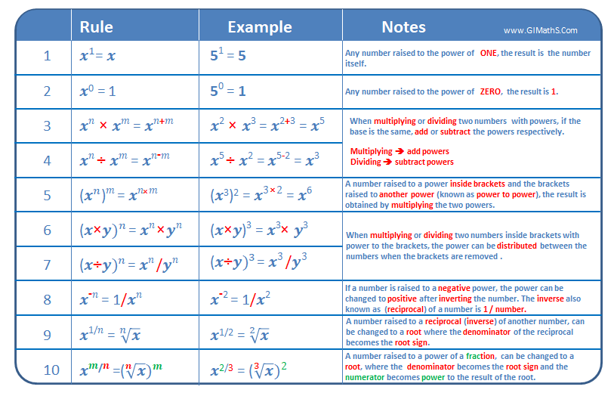

Slide 19
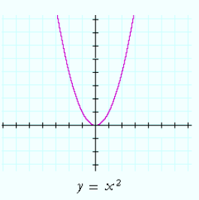
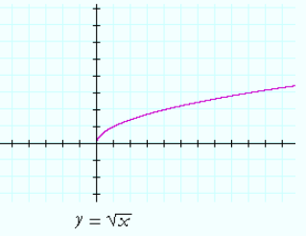
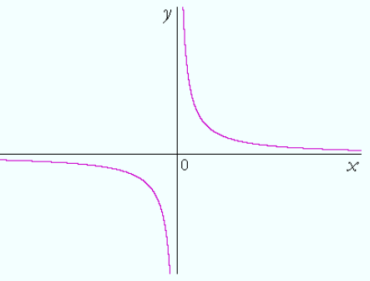
Some Power Function Graphs
y = x² y = x^{1/2} y = 1/x = x⁻¹
General form y = x^{z} x and z real; z fixed
[ also shifted forms: a(x-b)^{z} + c ]

Slide 20
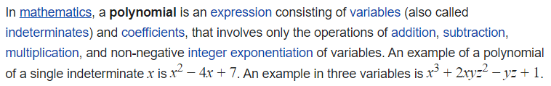

Polynomials

Slide 21
Polynomials
The highest order n is the degree of the Polynomial

Slide 22
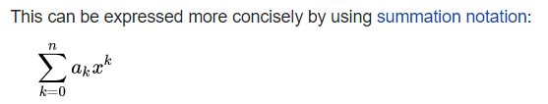
Polynomials

Slide 23
Polynomials
We will use Polynomials to characterise how complex Computer code is, that is how the runtime increases when the processed data does.
for ( i=0; i<n; i++ ) print( i ) ;
Needs ~ n computations

Slide 24
Polynomials
We will use Polynomials to characterise how complex Computer code is, that is how the runtime increases when the processed data does.
for ( j=0; j<n; j++ )
for ( i=0; i<n; i++ ) print( i ) ;
Needs ~ n² computations

Slide 25
Polynomials form a “Ring”
Polynomials can be added, subtracted, multiplied and divided similar to real numbers.
However, the division of two polynomials is not always a polynomial. Therefore the polynomials do not form a field like the real numbers. They only form what is called a ring in algebra.

Slide 26
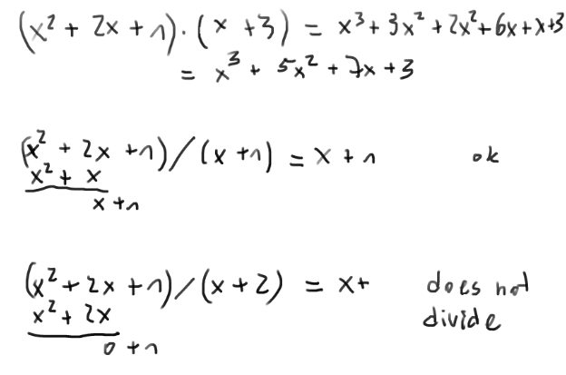

Slide 27
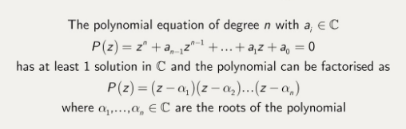
Fundamental Theorem of Algebra
Each polynomial can be fully factorised in C (the complex numbers).

Slide 28
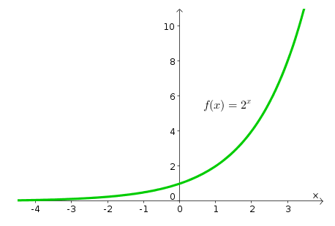
Exponential Function
Power function: y = x^{z} x and z real; z fixed
Exponential function: y = x^{z} x and z real; x fixed
x is called the base
Example: y = f(z) = 2^{z}
z 0 1 2 3 -1 -2 …
f(z) 1 2 4 8 ½ ¼ …

Slide 29
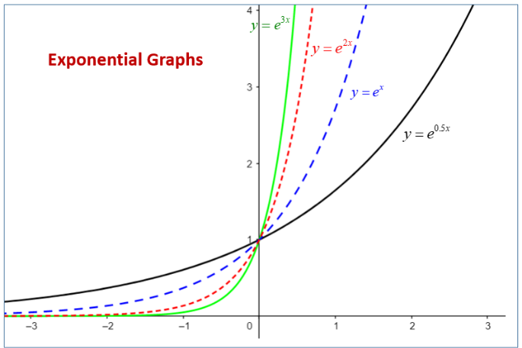

Exponential Functions
Base > 1
~ 2.71828 is Euler’s number; a natural constant

Slide 30
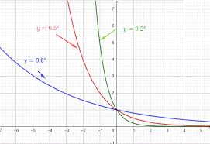
Exponential Functions
Base < 1
Note: 0.1 * 0.1 = 0.01

Slide 31
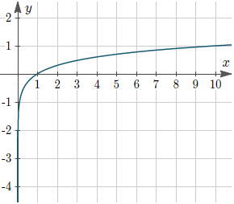
Logarithms
Logarithms are inverses of exponential functions
y = 10^{x} → x = log₁₀ y base 10
“What exponent x do we need to make 10^{x} equal to y ?”
100 = 10² → 2 = log₁₀ 100
1000 = 10³ → 3 = log₁₀ 1000
Logarithms grow very slowly

Slide 32
Logarithms
Logarithms are inverses of exponential functions
y = 10^{x} → x = log₁₀ y base 10
y = 2^{x} → x = log₂ y = ld y base 2; dual log.
y = e^{x} → x = log_{e} y = ln y base e; natural log.
Can use any base a>0
y = a^{x} → x = log_{a} y base a > 0

Slide 33
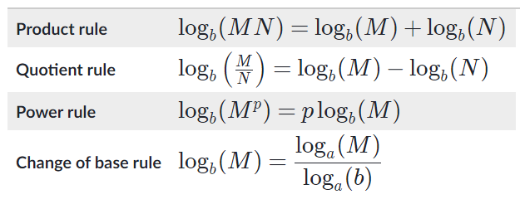
Log Rules

Slide 34
Logarithms
Logarithms are inverses of exponential functions
y = a^{x} → x = log_{a} y base a > 0
x = log_{a} a^{x} = x log_{a} a = x * 1 = x
y = a^{x} = a ^{log}_{a} ^{y} = y

Slide 35

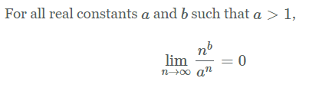
Asymptotics
“Large n behaviour”
Logarithms grow slower than any polynomial
Exponential functions grow faster than any polynomial

Slide 36
Derivatives

Slide 37
Derivatives describe the slope of functions
They occur in many contexts
They are functions themselves

Slide 38
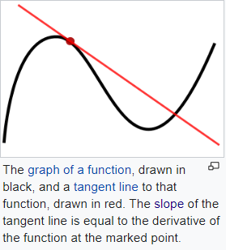
Derivatives describe function slope

Slide 39
Slope of a Line

Slide 40
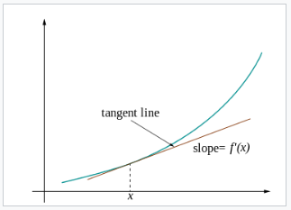
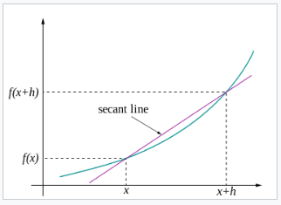
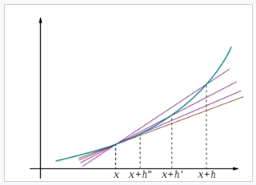
Limit of Secants approach Tangent

Slide 41
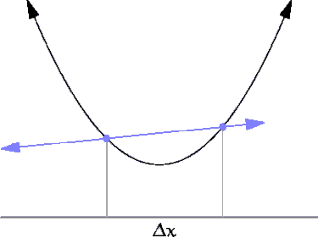
Secant Limit Animation

Slide 42
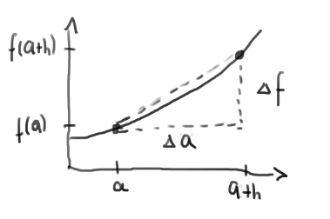


Secant Slope
Tangent slope :

Slide 43
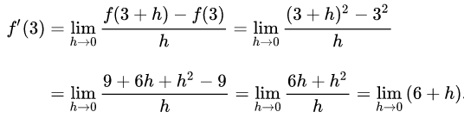
Example: f(a) = a² for a=3

Slide 44
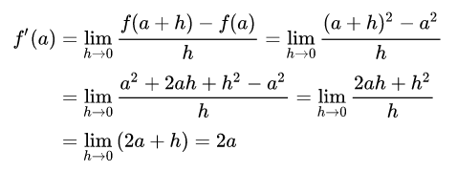
Example: f(a) = a² for any a

Slide 45
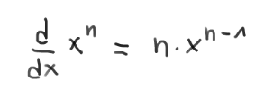
Example: f(a) = a² for any a
More generally
Derivative of power
Notation: df(x)/dx = f’(x)

Slide 46
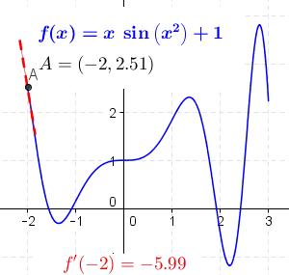
Derivative as a Function

Slide 47
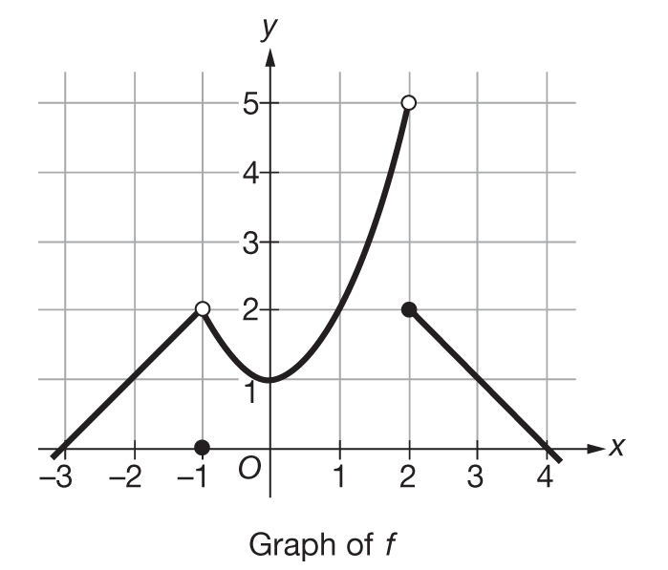
Continuity / Differentiability
A function does not need to be differentiable everywhere.
Discontinuous in 2
Discontinuous in -1
not differentiable in -1
Continuous and differentiable everywhere else

Slide 48
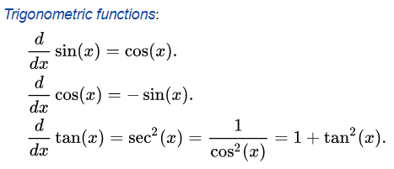

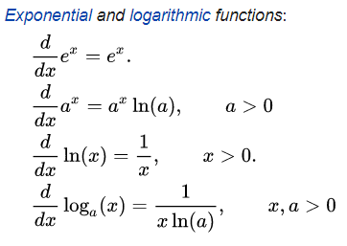
Derivatives of Common Functions
→ no need to compute the limits “by hand”

Slide 49
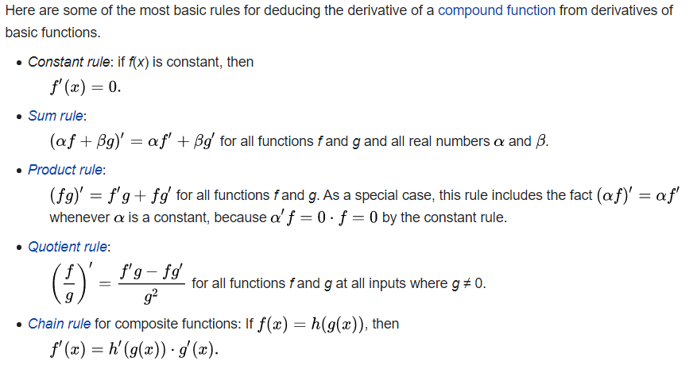
Rules for Compound Functions

Slide 50
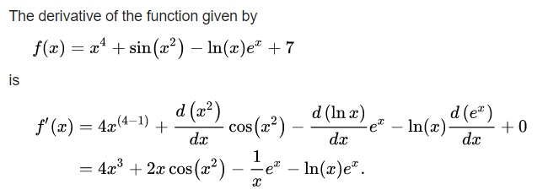
Example:
Compound Function Derivative

Slide 51
Higher order derivatives
We can successively computer higher order derivatives (not for all functions or everywhere)
Example: f(x) = x³ – 2x² + x + 5
f’(x) = 3x² – 4x + 1
f’’(x) = 6x – 4
f’’’(x) = 6
f^{(iv)} = 0

Slide 52
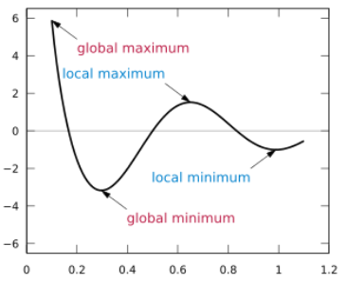
Extrema of Functions
Local extrema (maxima and minima) are characterized by vanishing slope, ie f’
Solving f’(x) = 0 results in possible extrema.
The second derivative f’’ must be different from 0.

Slide 53
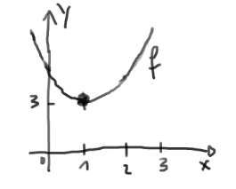
Example: f(x) = 3+2(x-1)²
f’(x) = 4(x-1)
f’(x₀) = 0 → x₀ = 1 → f(x₀) = 3
f’’(x₀) = 4 > 0 → the extremum is a minimum

Slide 54
Integration

Slide 55
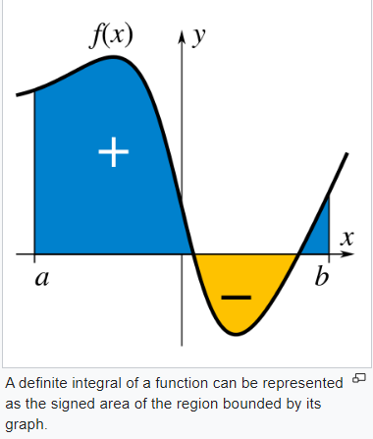
Integration is the inverse operation of derivation
It allows to compute “areas under a curve”

Slide 56
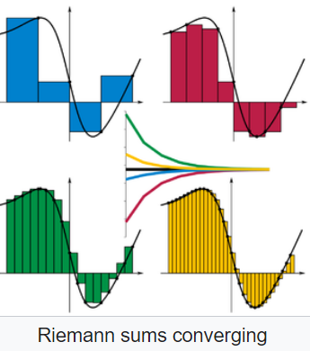
Riemann Sums
Area is approximated by slices of width h
Area is the sum over all slices
Sum converges to exact area if h converges to zero

Slide 57
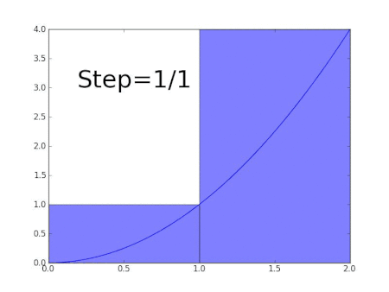

Slide 58
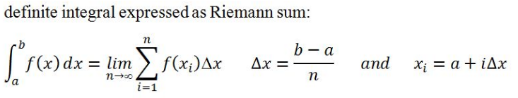
Notation of Integral
The wavy symbol refers to an S for Sum
dx indicates the integration variable x

Slide 59

Some Identities
Reversed bounds

Slide 60

Some Identities
Reversed bounds
Split integrals

Slide 61

Some Identities
Reversed bounds
Split integrals
Linearity

Slide 62
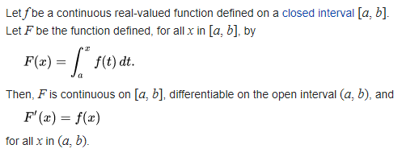
Fundamental Theorem of Calculus
Informal: “integration and derivative are inverses”

Slide 63
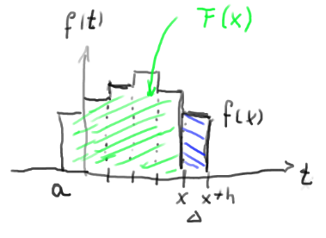

Informal Meaning
Green area is integral F(x). Advancing x by h adds just f(x)*h. Therefore, F changes at x by f(x) or F’(x) = f(x) as claimed.

Slide 64
Indefinite Integral
Indefinite integrals only refer to the inverse function property
They leave the integration boundaries out
Integral tables can be used for computations

Slide 65
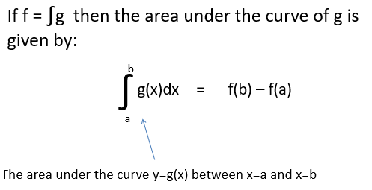
Fundamental Theorem of Calculus
Area under a Curve

Slide 66
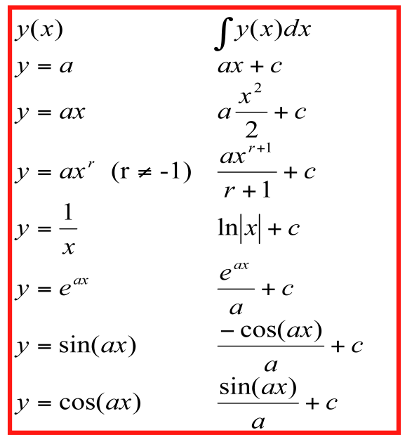
Integral Tables
… hundreds more .. log, sqrt, rational functions …

Slide 67
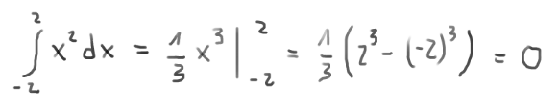
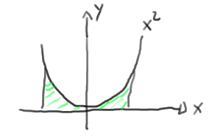
Example 1

Slide 68
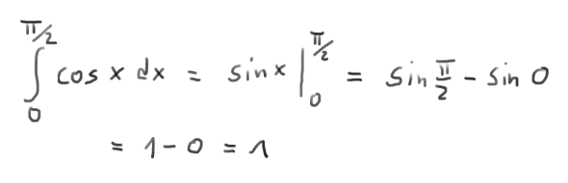
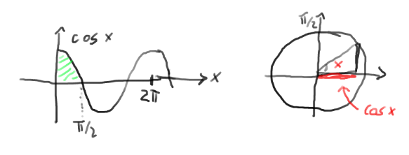
Example 2

Slide 69
Summary
Special functions are named functions that occur in common situations, log, sine, square..
Derivatives allow to compute slopes of functions and thereby maxima and minima
Integrals are inverses of derivatives. They allow to compute areas under a curve.

